Slide 1
Setting Yourself Up For Recruitment Success
A Student’s Perspective
IoT4Ag Professional Development Session
September 27th, 2024

Slide 2
Goals
How can you explore career options? When should you begin job searching?
What do non-academic employers look for in graduating students/fellow? How do you market yourself to non-academic employers?
What coursework or research decisions can you make now for future career success? What resources are available to you?

Slide 3
Goals
How can you explore career options? When should you begin job searching?
What do non-academic employers look for in graduating students/fellow? How do you market yourself to non-academic employers?
What coursework or research decisions can you make now for future career success? What resources are available to you?

Slide 4
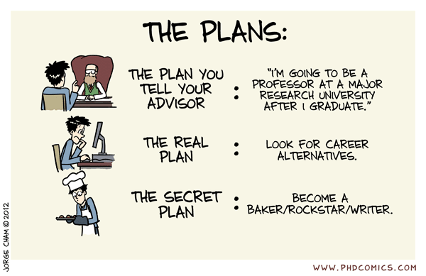
A guide to exploring your career options after a PhD/Postdoc
It’s never too early to begin considering your career options after graduation
A PhD prepares you for a variety of career options – the world is open to you!
Your PhD/postdoctoral field of study does not necessarily determine your career after
Your first job after your PhD/Postdoc also does not necessarily determine the rest of your life/career
Notes:
Maybe don’t start thinking about your post-phd career if you’re only in your first or second year of your phd
Case in point – being a student in IoT4Ag you have probably realized there are a variety of applications of a technology that you had never considered before and that opens up new career opportunities. A PhD as specific as it is, prepares you on how to apply scientific thinking and how to problem solve.

Slide 5
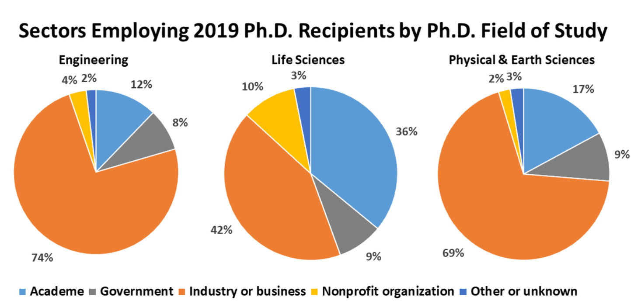
A guide to exploring your career options after a PhD/Postdoc: Discovery Stage
Clarifying questions to ask yourself:
What are your values and motivators and what kind of career would make you feel the most fulfilled?
Technical or Non-technical?
Industry or Academia? (or National Lab)?
What do you know you don’t want to do?
What are your areas of interest or industries of interest?
Are there any filtering factors? (Ex: visa status, geography, etc.)
National Center for Science and Engineering Statistics (NCSES). 2024. Doctorate Recipients from U.S. Universities: 2023 Data Tables. NSF 24-336. Alexandria, VA: U.S. National Science Foundation.
Notes:
Work-life balance, what kind of impact/contribution you want to make in the world
3. Based on your research experiences, any internships you have done
4. What aspects or projects of your PhD/postdoc have you enjoyed the most?

Slide 6
Goals
How can you explore career options? When should you begin job searching?
What do non-academic employers look for in graduating students/fellow? How do you market yourself to non-academic employers?
What coursework or research decisions can you make now for future career success? What resources are available to you?

Slide 7

A guide to exploring your career options after a PhD/Postdoc: Implementation Stage
Non-academic employers value:
Transferrable skills and experience
Evidence that knowledge/skills have been applied in real world settings with success
The ability to learn, grow and add value
Cultural fit
Notes:
Sounds like some vague jargon, but

Slide 8
A guide to exploring your career options after a PhD/Postdoc: Implementation Stage
Steps to take:
Conduct an inventory on all skills (technical and interpersonal) you have gained through the course of your PhD/Postdoc
  Stories/anecdotes of milestones, highs, lows of your PhD/Postdoc
Identify the outcomes/successes from all that you have accomplished – be specific!
  Think beyond the publishing of papers
Conduct an inventory of required skills/experience from the jobs of interest to you
  Job ads can range from useful to vague – spend time reading as many as you can
Identify a strategy for where, why and how you are applying to jobs of interest to you
  Job Boards (set alerts); Career Fairs (academic and professional); Networking (consider IoT4Ag IPAB members)
Notes:
Here are some concrete steps you can take as you write or update your resumes and as you start your job search

Slide 9
Goals
How can you explore career options? When should you begin job searching?
What do non-academic employers look for in graduating students/fellow? How do you market yourself to non-academic employers?
What coursework or research decisions can you make now for future career success? What resources are available to you?

Slide 10
Ways to prepare for successful recruitment:
Consider ways in which you can acquire the necessary skills for jobs of interest
  Take coursework in areas of interest
  Direct your research projects/collaborations towards areas of interest
  Acquire skill-specific certification/training through open-source platforms (Ex: Coursera, Udemy, etc.)
Consult your peers and graduated lab-mates for advice on recruitment, resume reviews, etc.
Take advantage of career resource centers at your universities and resources within IoT4ag
Notes:
At a certain stage in your PhD you do have some individual freedom to pursue projects of interest even if they are on the side, so you can use that to your advantage to gain experience in areas of interest or to acquire certain skills that you’ve identified as necessary for jobs your interestesd in

Slide 11
Thank You! Questions?

Slide 12

Word Cloud
What comes to your mind when you think about job searching?

Slide 13
Poll
At this time, what career path do you think you are most likely to pursue?

Slide 14
Poll
When was the last time you updated your resume?

Slide 15
Word Cloud
What additional career services resources would you like from IoT4Ag?

